Slide 1
Federal Work-Study Program at UNT Dallas
JoAnn Chapin
Student Solutions Coordinator and FWS Administrator

Slide 2
What is Federal Work-Study (FWS)?
Federal Work-Study provides part-time jobs for undergraduate and graduate students with financial need, allowing them to earn money to help pay education expenses. The program encourages community service work and work related to the student’s course of study.
Who qualifies for FWS?
To qualify for a Federal Work-Study award, a student must file the Free Application for Federal Student Aid (FAFSA), meet the general eligibility requirements for federal student aid, demonstrate financial need, and be enrolled or accepted for enrollment, as an undergraduate, graduate, or professional degree-seeking student.

Slide 3
How do I get a FWS student in my office/department?
Request a FWS position through the FWS Office.
Email: FWS@untdallas.edu or Phone: 972.338.1774
Create your job description.
Post the position on the UNT Dallas website and make sure you specify you are looking for FWS students only.
Notify the FWS office of the position you have posted so I can post the position on the FWS web page.
Once you have applicants, but before you interview, check their eligibility with the FWS Office to ensure your candidate is hirable using FWS funds.
Complete hiring process through campus HR.

Slide 4
How to hire and keep track of FWS student workers
Create ePAR to hire FWS student worker…
Use job code 1711 for fall
Use job code 1712 for spring
And use job code 1713 for summer. *Please note that summer work study is never guaranteed. You must have preapproval to use FWS students during the summer.
Attach the signed offer letter. (Offer letter must be signed by the supervisor, the FWS Administrator, Human Resources, and the student.)
FWS students can work a max of 20 hours per week.
Departments determine the rate of pay for the position, but keep in mind that the max award for a student is $5000 for the academic year. If you pay the student $9.00/hr, and they work 20 hours a week, they will barely make it through both fall and spring before running out of funding.
Keep track of all time on the Departmental Payroll Template you will receive from the FWS Office. The university currently has a $5,000 max offer for all FWS students. Some students will be eligible, but not for the max award. You will be responsible for calculating hours so that your student does not go over their award limit. If they do go over their award, the department will be responsible to repay the FWS funds they were overpaid or you can create an ePAR changing the chart string and job code over to be a regular student worker.

Slide 5
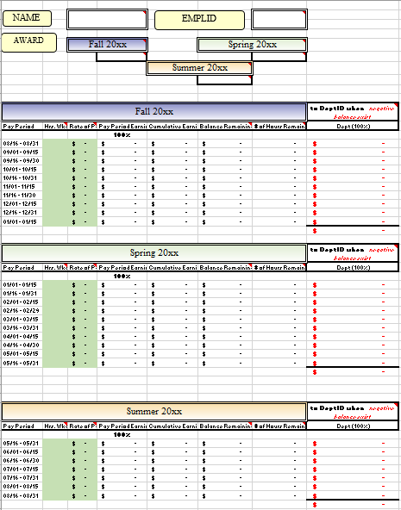
This is the Departmental Payroll Template.
This template will help you manage your student’s time and ensure not going over their award.

Slide 6
Important notes:
FWS positions are for fall and spring only. Summer is available, but under special circumstances only.
Fall work study award starts on 9/1/XX and ends on 1/15/XX
Spring work study award starts on 1/1/XX and ends on 5/31/XX
An ePAR needs to be completed to start working in the fall with the fall job code (1711) and a change ePAR will need to be created if the student will continue working in the spring with the spring job code (1712).
If you would like to keep FWS students from year to year, you will need to confirm with the FWS Office that funds are still available. Also, you should make sure the student is STILL eligible and has submitted their renewal FAFSA.

